Slide 1
Database Systems: Theory and Programming The Relational Data Model, Keys and SELECT
Notes:
Replace this with your course title and your name/contact details.

Slide 2
Types of Keys
Primary vs Foreign
Primary vs Alternate
Simple vs Composite
No keys in their entirety can contain NULLS.
However, the composite key can have NULLS in some attributes.
Super vs Candidate
Super key: Set of one or more attributes that uniquely identify a row.
Candidate key: A smallest possible superkey.

Slide 3
Referential Integrity
Referential integrity requires every value of one attribute (column) of a table to exist as a value of another attribute in a different table.
In this case, referential integrity (if enabled for these tables) would prohibit the alteration of a primary key of the VENDOR table (vendor_id), if that value was stored in the foreign key of the INVOICE table.
VENDORS table
INVOICES table

Slide 4
Referential Integrity (or foreign key) Constraint
Statement of the constraint
The value in the foreign key column (or columns) FK of the referencing relation R₁ can be either:
(1) a value of an existing primary key value of a corresponding primary key PK in the referenced relation R₂, or
(2) a null.

Slide 5
Update Operations and Dealing with Constraint Violations

Slide 6
Update Operations on Relations
INSERT a tuple.
DELETE a tuple.
MODIFY a tuple.
Integrity constraints should not be violated by the update operations.
Several update operations may have to be grouped together.
Updates may propagate to cause other updates automatically. This may be necessary to maintain integrity constraints.

Slide 7
Update Operations on Relations
In case of integrity violation, several actions can be taken:
Cancel the operation that causes the violation (RESTRICT or REJECT option)
Perform the operation but inform the user of the violation
Trigger additional updates so the violation is corrected (CASCADE option, SET NULL option)
Execute a user-specified error-correction routine

Slide 8
Possible violations for each operation
INSERT may violate any of the constraints:
Domain constraint:
if one of the attribute values provided for the new tuple is not of the specified attribute domain
Key constraint:
if the value of a key attribute in the new tuple already exists in another tuple in the relation
Referential integrity:
if a foreign key value in the new tuple references a primary key value that does not exist in the referenced relation
Entity integrity:
if the primary key value is null in the new tuple

Slide 9
Possible violations for each operation
DELETE may violate only referential integrity:
If the primary key value of the tuple being deleted is referenced from other tuples in the database
Can be remedied by several actions: RESTRICT, CASCADE, SET NULL (see Chapter 6 for more details)
RESTRICT option: reject the deletion
CASCADE option: propagate the new primary key value into the foreign keys of the referencing tuples
SET NULL option: set the foreign keys of the referencing tuples to NULL
One of the above options must be specified during database design for each foreign key constraint

Slide 10
Possible violations for each operation
UPDATE may violate domain constraint and NOT NULL constraint on an attribute being modified
Any of the other constraints may also be violated, depending on the attribute being updated:
Updating the primary key (PK):
Similar to a DELETE followed by an INSERT
Need to specify similar options to DELETE
Updating a foreign key (FK):
May violate referential integrity
Updating an ordinary attribute (neither PK nor FK):
Can only violate domain constraints

Slide 11
Database Systems: Theory and Programming
Basic Retrieval Queries in SQL

Slide 12
SELECT Syntactical Elements
← What columns do you want?
← From which tables?
← What are your conditions? (What rows do you want?)
← In what order?
← How many results?

Slide 13
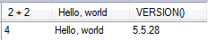
FROM clause is not needed
SELECT 2 + 2, 'Hello, world', VERSION();

Slide 14
Practice using the President table
Select all rows, all columns
SELECT * FROM sampdb.president;
Select certain columns, all rows
SELECT * FROM sampdb.president WHERE last_name='Bush';
Select certain columns
SELECT last_name, city, state FROM sampdb.president;
Select certain columns, certain rows (even a single cell)
SELECT birth FROM sampdb.president WHERE last_name = 'Nixon';
If you name more than one column, separate them by commas.

Slide 15
Relatively Case Insensitive
Commands and column names are not case sensitive in MySQL
SELECT name, student_id FROM student;
SELECT NAME, STUDENT_ID FROM student;
SELECT nAmE, sTuDeNt_Id FROM student;
Select name, student_id FrOm student;
Database and table names might be case sensitive. It depends on:
the filesystem used on the server host
how MySQL is configured.
Windows and Mac OS X: database and table names →case insensitive
UNIX and Linux: database and table names →case sensitive.
MySQL can configure database and table names to be case insensitive.
equivalent

Slide 16
No Values Retrieved

Slide 17
Full Syntax of SELECT

Slide 18
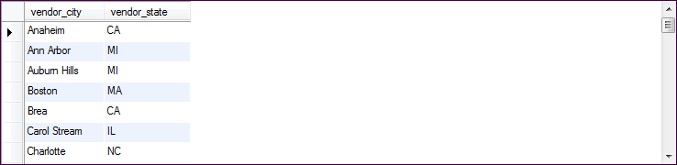
Using DISTINCT

Slide 19
Column Aliases

Slide 20
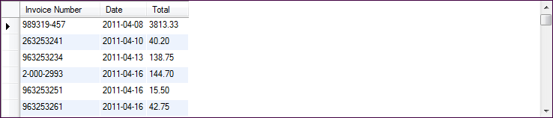
Column Alias
column alias

Slide 21
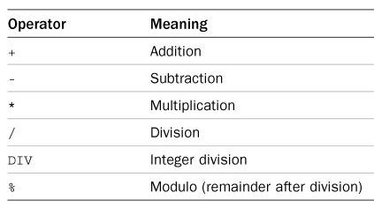
Performing Calculations

Slide 22
Performing Calculations

Slide 23
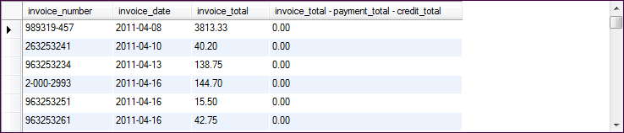
Calculations Without an Alias

Slide 24
Column aliases important when using SQL functions
select if(last_name = 'Bush', concat(last_name, ' - ', state), last_name) AS last_name, ifnull(death, 'still alive') AS death from sampdb.president where death >= '2000-01-01' OR death is null;
select left(first_name, 1) AS first_initial, last_name from sampdb.president;
last_name | death
Ford | 2006-12-26
Carter | still alive
Reagan | 2004-06-05
Bush - MA | still alive
Clinton | still alive
Bush - CT | still alive
Obama | still alive
first_initial | last_name
G | Washington
J | Adams
T | Jefferson
J | Madison
J | Monroe

Slide 25
Order of Operations

Slide 26
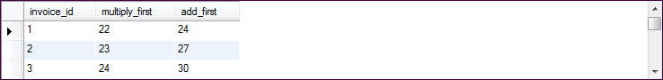
Using Parentheses

Slide 27
Quick Preview of Functions

Slide 28
What About Single Quotes You Want?
Two single quotes in a row inside terminal single quotes

Slide 29

Functions (e.g. LEFT)
arguments

Slide 30
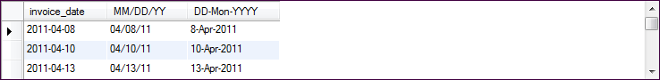
Formatting Dates

Slide 31
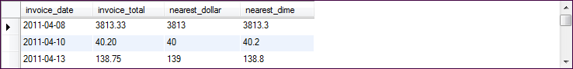
ROUND Function
Square brackets mean optional.
arguments

Slide 32
WHERE clauses

Slide 33
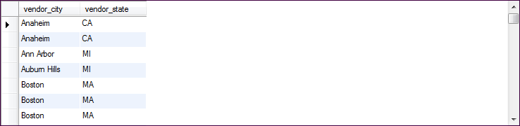
WHERE clauses
No where clause...

Slide 34
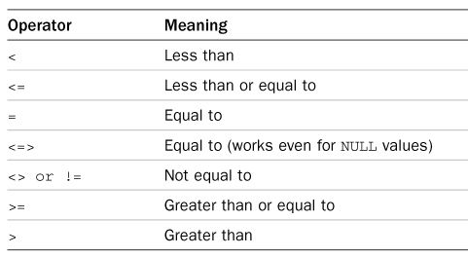
Comparison Operators

Slide 35
WHERE Clause Examples

Slide 36
Pattern Matching with LIKE
Wildcard symbols
% Multiple characters
_ One character

Slide 37
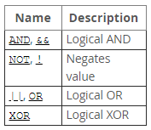
Remember Boolean Logic

Slide 38
IN and BETWEEN

Slide 39
The IN phrase

Slide 40
BETWEEN phrase
Between is inclusive!

Slide 41
NULLs

Slide 42

Comparisons Involving NULL and Three-Valued Logic
see page
208
Meanings of NULL
Unknown value e.g., a person's DOB is truly not known
Unavailable or withheld value e.g., a person does not want their email address stored
Not applicable attribute e.g., a person's highest college degree achieved is not applicable to a high school student
Each individual NULL value considered to be different from every other NULL value
SQL uses a three-valued logic:
TRUE, FALSE, and UNKNOWN (like Maybe)
NULL = NULL comparison is avoided

Slide 43
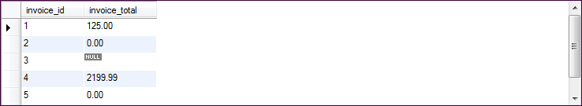
NULLs Mean Empty
Never use =, != or <>

Slide 44
Zero is not same as NULL.

Slide 45
Working with Dates

Slide 46
Date Syntax
MySQL is that it always expects dates with the year first.
To write July 27, 2012, use '2012-07-27'.
SELECT last_name, first_name, birth, state FROM president WHERE birth < '1750-01-01'

Slide 47
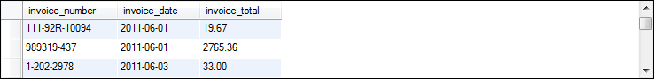
Selecting Based on Date Range

Slide 48
ORDER BY

Slide 49
How Sorting Works

Slide 50

Reverse (Descending) Sort

Slide 51
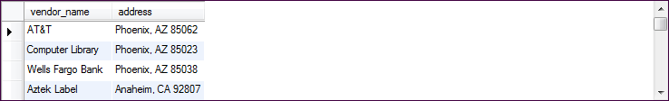
Secondary, Tertiary… Sorts

Slide 52

ORDER BY with an Alias

Slide 53
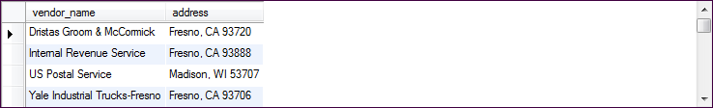
ORDER BY Fields Do Not Have to Be in Base Table

Slide 54
ORDER BY with Column Positions

Slide 55
LIMIT

Slide 56
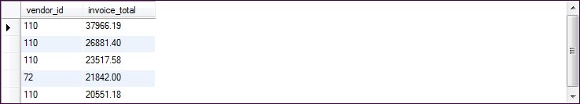
LIMIT Clause

Slide 57
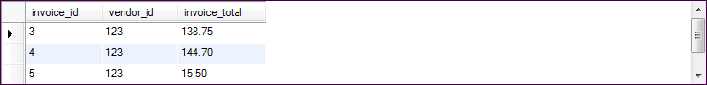
Skipping the First Few Rows (1)

Slide 58
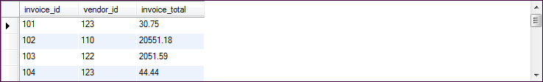
Skipping the First Few Rows (2)

Slide 59
Using a Table Alias
Tables aliases are not that important when selecting data from a single table.

Slide 60
Regular Expressions

Slide 61
Regular Expressions
Not case-sensitive!
← Match beginning of string
← Match end of string
← Match any character
← Match zero or more 'a' characters
Match one or more 'a' characters
Match zero or one 'a' character
Match any character in the list
Match any characters in the range between start & end
Or. Match what is on either side.

Slide 62
WHERE clauses using REGEXP Operator (1)

Slide 63
WHERE clauses using REGEXP Operator (1)

Slide 64
Advanced Queries

Slide 65
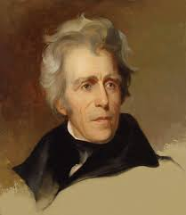
Using Variables
MySQL enables you to define your own variables (identified by @)
These can be set using query results, which provides a convenient way to save values for use in later queries.
Which presidents were born before Andrew Jackson?
SELECT @jackson_birth := birth FROM president WHERE last_name = 'Jackson' AND first_name = 'Andrew';
SELECT last_name, first_name, birth FROM president WHERE birth < @jackson_birth ORDER BY birth;
retrieve Jackson's birth date into a variable
select other presidents with a birth date earlier than the value of the variable

Slide 66

Practice From Last Lesson (plus adding variables)
Display the title and length of the ten longest G rated movies. Control Anthem, Darn Forrester, Muscle Bright, Moonwalker Fool, Catch Amistad, Young Language, Baked Cleopatra, Intrigue Worst, Lawless Vision, Mussolini Spoilers
Display the titles, descriptions and length of all movies longer than the interminable 'SORORITY QUEEN' Chicago North, Control Anthem, Darn Forrester, Gangs Pride, Home Pity, Muscle Bright, Pond Seattle, Soldiers Evolution, Sweet Brotherhood, Worst Banger
Find all movies involving a car (use the description) that manage to conclude in a third of the time (or less) than 'SORORITY QUEEN' Ace Goldfinger, Adaptation Holes, Excitement Eve, Go Purple, Hawk Chill, Heaven Freedom, Juggler Hardly, Kwai Homeward, Mockingbird Hollywood, Natural Stock, Paradise Sabrina, Reservoir Adaptation
Consider all the movies that involve a cow and a pastry chef. Then find all the movies whose length is between the shortest such movie and the longest such movie. Oh, and make sure the movies you find are G rated and involve a frisbee. Affair Prejudice, Diary Panic, Dude Blindness, Glass Dying, Mob Duffel, Operation Operation, Secrets Paradise, Sweethearts Suspects

Slide 67
Answers
SELECT title, length FROM sakila.film WHERE rating='G'
ORDER BY length DESC, title LIMIT 10;
SELECT @sorority_queen_length := length FROM sakila.film
WHERE title = 'SORORITY QUEEN';
SELECT title, description, length FROM sakila.film
WHERE length > @sorority_queen_length;
SELECT title, description, length FROM sakila.film
WHERE length <= @sorority_queen_length/3 AND description REGEXP 'car';
SELECT @longest_cow_chef_movie := length FROM sakila.film
WHERE description REGEXP 'cow' AND description REGEXP 'pastry chef'
ORDER BY length DESC LIMIT 1;
SELECT @shortest_cow_chef_movie := length FROM sakila.film
WHERE description REGEXP 'cow' AND description REGEXP 'pastry chef'
ORDER BY length ASC LIMIT 1;
SELECT title, description, length
FROM sakila.film
WHERE length BETWEEN @shortest_cow_chef_movie and @longest_cow_chef_movie AND rating = 'G' AND description REGEXP 'frisbee';

Slide 68
Table and Column Aliases
To refer to a table, you have two choices:
Fully qualified table name: a database identifier and a table identifier:
SHOW COLUMNS FROM db_name.tbl_name; SELECT * FROM db_name.tbl_name;
A table identifier by itself refers to a table in the default (current) database.
If sampdb is the default database, the following statements are equivalent: SELECT * FROM member; SELECT * FROM sampdb.member;
To refer to a table column, you have three choices:
Fully qualified column: db_name.tbl_name.col_name
Partially qualified name: written as tbl_name.col_name
Unqualified name written simply as col_name

Slide 69
Using a Table Alias
Column names are said to be "qualified" by the table name or alias
Tables aliases are not that important when selecting data from a single table.

Slide 70
Full SELECT Syntax
SELECT select_list # the columns to select FROM table_list # the tables from which to select rows WHERE row_constraint # the conditions rows must satisfy GROUP BY grouping_columns # how to group results ORDER BY sorting_columns # how to sort results HAVING group_constraint # the conditions groups must satisfy LIMIT [offset,] count; # row count limit on results

Slide 71
Retrieving Data from Multiple Tables
To work with multiple tables in SQL, you need to join one table to one or more other tables.
Types of joins
Inner Join
Outer Join
Natural Join
Cross Join

Slide 72
Simple Inner Joins

Slide 73
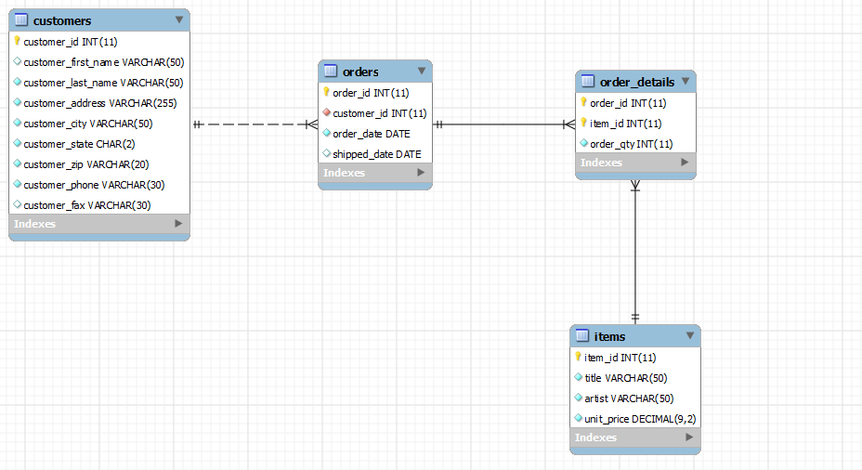
A Look at the OM Schema
A customer may have one or many orders
An order may have one or more order details
An order is associated with one and only one customer
Order details refer to one and only one order
An item may appear in multiple order details
Order details refer to one and only one order
"I want to see Korah Blanca's
order history."
Note:
The customer_id field is not part of order's primary key
This is known as a non-identifying relationship
Denoted by the dashed line.

Slide 74
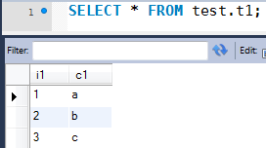
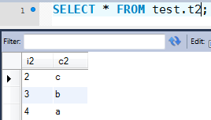
Practicing Types of Joins
Create two tables in the test database, and populate them as below*:
Create the script on the right and execute it
How many rows did each query retrieve?
What were the differences (if any) between the query results?
SELECT t1.*, t2.* FROM t1, t2;
SELECT * FROM t1, t2; SELECT * FROM t2, t1; SELECT * FROM t1 CROSS JOIN t2; SELECT * FROM t2 CROSS JOIN t1; SELECT * FROM t1 JOIN t2; SELECT * FROM t2 JOIN t1; SELECT * FROM t1 INNER JOIN t2; SELECT * FROM t2 INNER JOIN t1;
*or run queries from sampdb

Slide 75
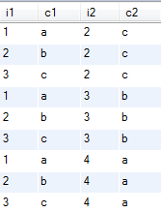
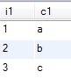
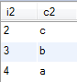
Cartesian Product
What you have seen is a Cartesian Product.
Every row of table one was joined with every row of table two.
If you add a WHERE clause causing tables to be matched on the values of certain columns, the join selects only rows with equal values in those columns:

Slide 76
Back to Our Question
A customer may have one or many orders
An order may have one or more order details
An order is associated with one and only one customer
Order details refer to one and only one order
An item may appear in multiple order details
Order details refer to one and only one order
"I want to see Korah Blanca's
order history."
Note:
The customer_id field is not part of order's primary key
This is known as a non-identifying relationship
Denoted by the dashed line.

Slide 77
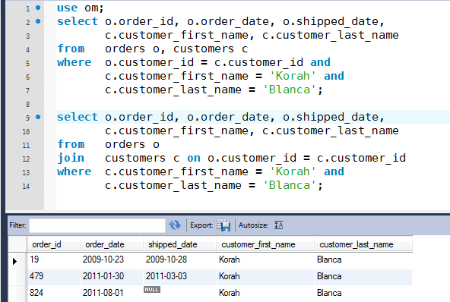
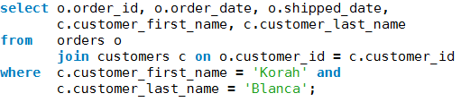
"Old-style" Table Joins (implicit INNER JOIN)
The join
condition
Valid, but "out of style"
Easier to
read and maintain. Join condition
separated
from row
filtering
conditions.

Slide 78
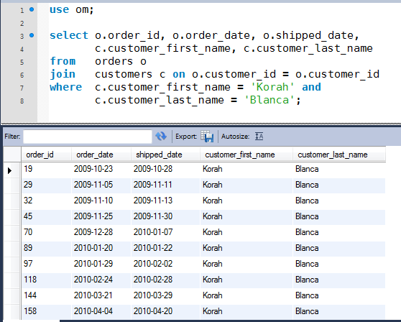
Be careful when you JOIN
One typo can lead to misleading and dangerous results.
Cartesian
Product
And so on, and so on…

Slide 79
The JOIN clause
While you do not need to use a JOIN clause for table joins (if you have used implicit join conditions in your WHERE clause), it is more efficient to use explicit JOIN syntax.
Multiple syntax for explicit JOIN clause: 'ON' or 'USING'
ON clause
SELECT * FROM test.emp JOIN test.dept ON (emp.dept_no = dept.dept_no);
ON can be used regardless of whether the joined columns have the same name.
USING() clause
Similar in concept to ON, but the name of the joined column or columns must be the same in each table.
SELECT * FROM test.emp JOIN test.dept USING (dept_no);
Try both SQL statements what is the difference?

Slide 80
ON vs. USING
ON
You need to specify both qualified columns using the = operator.
Operation will retrieve both qualified columns in the result set.
More explicit
Parentheses not required
Necessary when key columns are not named the same
USING
You only need specify the common columns for the JOIN.
Operation will retrieve the common column only once.
Easier syntax (but requires parentheses)
Less overhead (dupe columns not returned)

Slide 81
USING
The USING(column_list) clause names a list of columns that must exist in both tables. If tables a and b both contain columns c1, c2, and c3, the following join compares corresponding columns from the two tables:
FROM a JOIN b USING (c1,c2,c3)

Slide 82
Column Ambiguity
References to each table column throughout a SELECT statement must resolve unambiguously to a single table named in the FROM clause.
If only one table is named, there is no ambiguity; all columns must be columns of that table.
If multiple tables are named, any column name that appears in only one table is similarly unambiguous.

Slide 83
A Note on Syntax and Style
Normal joins, as we have just seen, are referred to as inner joins.
Lining up your SQL and placing the join condition on one line improves readability.
select o.order_id, o.order_date, o.shipped_date, c.customer_first_name, c.customer_last_name from om.orders o join customers c on (o.customer_id = c.customer_id) where c.customer_first_name = 'Korah' and c.customer_last_name = 'Blanca';
Use table aliases for all columns, whether needed or not
FROM: One table per line WHERE: One condition per line
Parens optional, but ⬆ readability
Good query documentation!

Slide 84
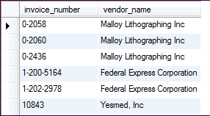
An Inner Join Example

Slide 85
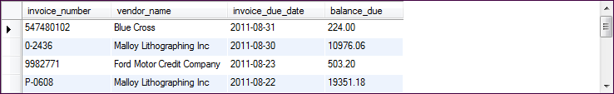
Another Example

Slide 86
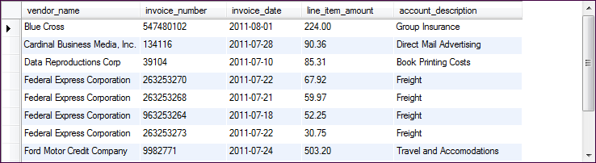
A Four Table Join

Slide 87
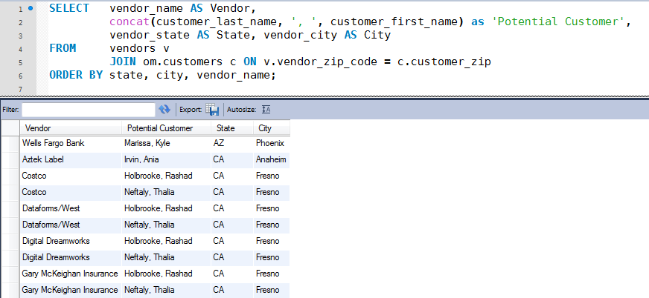
Database (Schema) Name Needed if Joining Across Databases
Query uses Ad Hoc relationships
that are not built on database keys.
NOTE: Query modified from page 121
to make results clearer.

Slide 88
More on Syntax and Style
Best to follow the full conventions when coding professionally
All columns identified by table name or table alias
All tables identified by database name
select o.order_id, o.order_date, o.shipped_date, c.customer_first_name, c.customer_last_name from om.orders o join customers c on o.customer_id = c.customer_id where c.customer_first_name = 'Korah' and c.customer_last_name = 'Blanca';

Slide 89
More Complex Inner Joins
Composite Keys
Self Joins

Slide 90
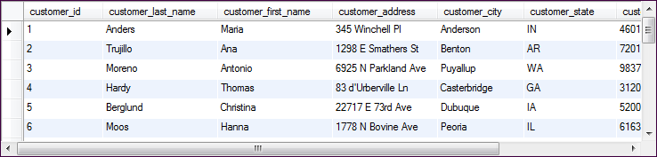
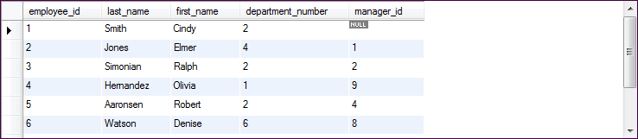
Joining with Multiple Columns (1)
"Is it possible that some of our employees are also customers?"

Slide 91
Joining with Multiple Columns (2)

Slide 92
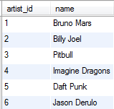
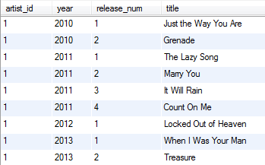
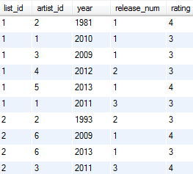
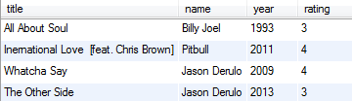
An Example
Bruno Mars 1st release in 2013 was "When I Was Your Man" His 2nd release in 2013 was "Treasure"
test.single
test.artist
test.playlist
How can we display the songs on playlist 2?

Slide 93
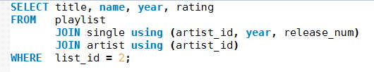
Bruno Mars 1st release in 2013 was "When I Was Your Man" His 2nd release in 2013 was "Treasure"
An Example
test.single
test.artist
test.playlist
How can we display the songs on playlist 2?

Slide 94
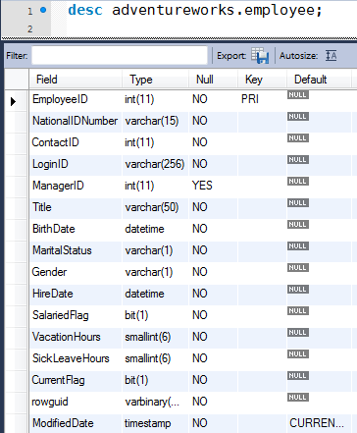
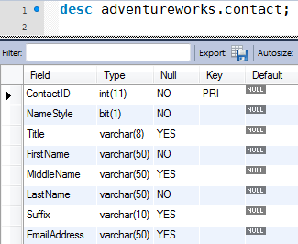
Self Joins: A New Example
"I want to know Dan Bacon's, hire date, and the name of his manager."

Slide 95
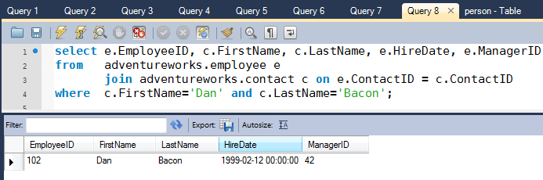
The First Part is Easy

Slide 96
The First Part is Easy
How do we get the name of Dan's Manager (ManagerID=42)?
Dan's Manager is also an employee, so we need to join the employee table to itself to get #42's ContactID.

Slide 97
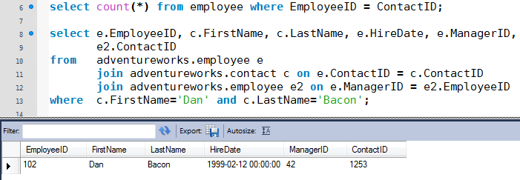
A Self Join (requires a separate table alias)
Closer, but still don't have manager name.

Slide 98
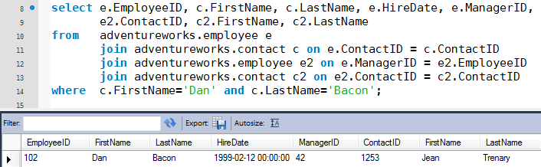
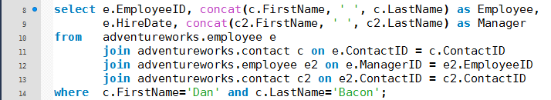
The Final Results
Clean up ambiguity, and remove unnecessary columns from SELECT

Slide 99
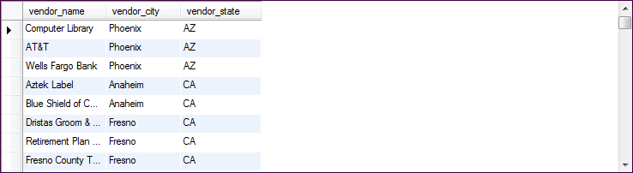
Another self-join example

Slide 100
Outer Joins

Slide 101
Outer versus Inner Joins
An inner join shows only rows where a match can be found in both tables.
An outer join shows matches, too, but can also show rows in one table that have no match in the other table.
Two kinds of outer joins:
LEFT JOINS: identify rows in the left table not matched by the right table.
RIGHT JOINS: the same except that the roles of the tables are reversed.

Slide 102
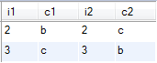
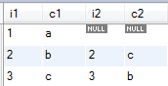
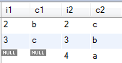
Examples of Outer Join
SELECT t1.*, t2.* FROM t1 JOIN t2 ON (t1.i1 = t2.i2);
SELECT t1.*, t2.* FROM t1 LEFT JOIN t2 ON (t1.i1 = t2.i2);
SELECT t1.*, t2.* FROM t1 RIGHT JOIN t2 ON (t1.i1 = t2.i2);

Slide 103
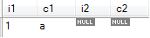
LEFT JOIN Finding Unmatched Rows
LEFT JOIN is especially useful when you want to find only those left table rows that are unmatched by the right table.
Do this by adding a WHERE clause that selects only the rows that have NULL values in a right table column— in other words, the rows in one table that are missing from the other.
SELECT t1.*, t2.* FROM t1 LEFT JOIN t2 ON t1.i1 = t2.i2 WHERE t2.i2 is NULL;
Often used with primary and foreign keys for data integrity checks
SELECT emp_name FROM emp LEFT JOIN dept using (dept_no) WHERE dept.dept_no is null;

Slide 104
Definition of Outer Join
An outer join does not require each record in the two joined tables to have a matching record. The joined table retains each record — even if no matching record exists.
Left outer join
The result of a left outer join for table A and B always contains all records of the "left" table (A), even if the join-condition does not find any matching record in the "right" table (B).
This means that if the ON clause matches 0 (zero) records in B (for a given record in A), the join will still return a row in the result (for that record)—but with NULL in each column from B.
Right outer join
Contains all records of the "right" table (B), even if the join-condition does not find any matching record in the "left" table (A).
select a.field, b.field
from a
left join b on a.key = b.key;
select a.field, b.field
from a
right join b on a.key = b.key;

Slide 105
Definition of Outer Join
Another way to think about it
TABLE
a
TABLE
b
select a.field, b.field
from a
left join b on a.key = b.key;
Table a is the "driver." It will force a match against Table b.
TABLE
a
TABLE
b
select a.field, b.field
from a
right join b on a.key = b.key;
Table b is the "driver." It will force a match against Table a.

Slide 106
Outer Join Syntax

Slide 107

Example of LEFT JOIN

Slide 108



Employees, Departments and Projects (in database ex)
Projects Table
Departments Table
Employees Table
Better named
"Project Assignment"
table. Why??

Slide 109

Example of LEFT OUTER JOIN
"Departments with or without Employees"

Slide 110

Example of RIGHT OUTER JOIN
"Employees with or without Departments"

Slide 111

Multiple Outer Joins
"Departments with or without Employees whether the Employees have projects or not.

Slide 112

More Permutations
"Departments with Employees whether the Employees have projects or not.

Slide 113

USING Example

Slide 114

USING with Three Tables

Slide 115


AdventureWorks 2005 Partial Model
FK1
FK3
FK2
FK2
FK1, FK2
FK1
FK1
FK1
FK1
FK1
FK1
FK2

Slide 116
Natural Join

Slide 117

NATURAL JOIN
The NATURAL [LEFT] JOIN of two tables is defined to be semantically equivalent to an INNER JOIN or a LEFT JOIN with a USING clause that names all columns that exist in both tables.
A natural join is a type of join where the join predicate arises implicitly by comparing all columns in both tables that have the same column-names in the joined tables. The resulting joined table contains only one column for each pair of equally named columns.
Most experts agree that NATURAL JOINs are dangerous and therefore strongly discourage their use
Inadvertently add a new column, named the same as another column in the other table.
Example, adding "DATE_MODIFIED" column to two tables.

Slide 118

NATURAL JOIN Example

Slide 119
Cross Join

Slide 120
CROSS JOIN
CROSS JOIN returns the Cartesian product of rows from tables in the join. In other words, it will produce rows which combine each row from the first table with each row from the second table.
Example of an explicit cross join:
SELECT * FROM employee CROSS JOIN department;
Example of an implicit cross join:
SELECT * FROM employee, department;
Often by Cartesian Products are by mistake, but sometimes they are useful.

Slide 121



Good Use of a CROSS Join
Pre-populating a Join table
insert into Sales (StoreID, ProductID) select StoreID, ProductID from Store cross join Product
Store Table
Product Table
Sales Table

Slide 122


CROSS JOIN
140-141

Slide 123
Without a JOIN clause or a join statement in where clause…

Slide 124

Let's Consider the Student Grade Problem (1)
There are 31 students, but we only have complete grades for event 3.
How would we get all student grades (including NULLs) for event 6?
Can we take the student table and LEFT JOIN it with the grade_event table?
SELECT event_id, date, category, count(*) as 'Number of Grades'
FROM score NATURAL JOIN grade_event GROUP BY event_id;

Slide 125
Let's Consider the Student Grade Problem (1)
There are 31 students, but we only have complete grades for event 3.
How would we get all student grades (including NULLs) for event 6?
Can we take the student table and LEFT JOIN it with the grade_event table?
No. This technique would force all rows of student to be retrieved even if a student id could not be matched in the grade_event table. Since every student has taken at least one test or quiz, a LEFT JOIN would return the same results as an INNER JOIN.
SELECT event_id, date, category, count(*) as 'Number of Grades'
FROM score NATURAL JOIN grade_event GROUP BY event_id;

Slide 126

Let's Consider the Student Grade Problem (2)
student_id | name
1 | Megan
2 | Joseph
3 | Kyle
4 | Katie
5 | Abby
6 | Nathan
7 | Liesl
8 | Ian
9 | Colin
10 | Peter
11 | Michael
12 | Thomas
13 | Devri
14 | Ben
15 | Aubrey
16 | Rebecca
student_id | name
17 | Will
18 | Max
19 | Rianne
20 | Avery
21 | Lauren
22 | Becca
23 | Gregory
24 | Sarah
25 | Robbie
26 | Keaton
27 | Carter
28 | Teddy
29 | Gabrielle
30 | Grace
31 | Emily
etc…
What if we had a table that looked like this?
We could use OUTER JOIN to force this row to match.
student_id | event_id
1 | 4
2 | 4
3 | 4
4 | 4
5 | 4
6 | 4

Slide 127
Let's Consider the Student Grade Problem (3)
But we CAN get a table that associates every student with every grading event!
How?
CROSS JOIN student and grade_event.
What is the SQL?
etc…
What if we had a table that looked like this?
We could use OUTER JOIN to force this row to match.
student_id | event_id
1 | 4
2 | 4
3 | 4
4 | 4
5 | 4
6 | 4

Slide 128
Let's Consider the Student Grade Problem (4)
But we CAN get a table that associates every student with every grading event!
How?
CROSS JOIN student and grade_event.
etc…
SELECT student.student_id,
student.name, score
FROM student
CROSS JOIN grade_event
LEFT JOIN score USING (student_id, event_id)
WHERE grade_event.event_id = 4
ORDER BY student_id
student_id | event_id
1 | 4
2 | 4
3 | 4
4 | 4
5 | 4
6 | 4
What if we had a table that looked like this?
We could use OUTER JOIN to force this row to match.

Slide 129

Try This
Find the students who have missing test or quiz grades

Slide 130
Solution
SELECT name, student_id, date, event_id, category FROM student CROSS JOIN grade_event LEFT JOIN score USING (student_id, event_id) WHERE score IS NULL ORDER BY student.student_id, grade_event.event_id;
This uses USING instead of ON. If we had used ON, how would this query have changed?

Slide 131
Unions

Slide 132
UNIONS

Slide 133

Example of UNION (multiple tables)

Slide 134

Example of UNION (single table)

Slide 135
Each part of the UNION may involve JOINs

Slide 136

Results

Slide 137
How a UNION works
The column names for the UNION result come from the names of the columns in the first SELECT.
The second and subsequent SELECT statements in the UNION must select the same number of columns, but corresponding columns need not have the same names or data types.
(Normally, you write a UNION such that corresponding columns do have the same types, but MySQL performs type conversion as necessary if they do not.)
Column matching occurs by position rather than by name.
By default, UNION eliminates duplicate rows from the result set. To preserve duplicates, change each UNION to UNION ALL.

Slide 138



Some Examples
SELECT 'HTML' as color_type, color_name FROM html_colors UNION SELECT 'Crayola', color FROM crayola_colors ORDER BY color_name;
B
SELECT color_name FROM html_colors UNION SELECT color FROM crayola_colors ORDER BY color_name;
SELECT color_name FROM html_colors UNION ALL SELECT color FROM crayola_colors ORDER BY color_name;
A
C

Slide 139

Full Outer Join
"I want to see all employees and
departments, whether or not they are linked.
Known as full outer join
Possible in Oracle and SQL Server but not MySQL!

Slide 140
Full Outer Join Simulation in MySQL
Left Join
UNION
Right Join

Slide 141

Results

Slide 142
Exercises
http://jackmyers.info/db/exercises/
Table Joins (Exercises 1 – 7 on page 148)

Slide 143

Practice
Go to the Exercises folder, http://jackmyers.info/db/exercises/
Do "Joining Tables In Adventure Works" exercise.

Slide 144

Database Systems: Theory and Programming
Section 7.17
Aggregate Functions in SQL

Slide 145
Aggregate Functions
These functions operate on the multiset of values of a column of a relation, and return a value
avg: average value min: minimum value max: maximum value sum: sum of values count: number of values

Slide 146
Aggregate Functions (Cont.)
Find the average salary of instructors in the Computer Science department
select avg (salary) from instructor where dept_name= ’Comp. Sci.’;
Find the total number of instructors who teach a course in the Spring 2012 semester
select count (distinct ID) from teaches where semester = ’Spring’ and year = 2012;
Find the number of rows in the course relation
select count (*) from course;

Slide 147
What can you count?
USE sampdb;
SELECT COUNT(*), COUNT(email), COUNT(distinct email), COUNT(expiration), COUNT(distinct expiration) FROM member;
SELECT COUNT(*) FROM student WHERE sex = 'M';

Slide 148

Count and UNION can be Powerful
Use the modified Sakila database to produce statistics on the categories of movies. Produce the report below:
Wait, how many movies are in the database?
Do these numbers add up?

Slide 149
Record Count and Sum

Slide 150
Into the Mix: AVG and a Function

Slide 151
MIN and MAX

Slide 152
MIN and MAX work on Character Data

Slide 153
Pairing Summary Functions with DISTINCT

Slide 154
Summary Breakdowns

Slide 155
Database Systems: Theory and Programming
Section 7.18
Grouping: The GROUP BY and HAVING clauses

Slide 156

Full SELECT Syntax
2.8
SELECT select_list # the columns to select FROM table_list # the tables from which to select rows WHERE row_constraint # the conditions rows must satisfy GROUP BY grouping_columns # how to group results ORDER BY sorting_columns # how to sort results HAVING group_constraint # the conditions groups must satisfy LIMIT [offset,] count; # row count limit on results

Slide 157


Aggregate Functions – Group By
Find the average salary of instructors in each department
select dept_name, avg (salary) from instructor group by dept_name;
avg_salary

Slide 158

Warning! MySQL does NOT enforce this!
Attributes in select clause outside of aggregate functions must appear in group by list
/* erroneous query */ select dept_name, ID, name round(avg(salary),0) as salary from instructor group by dept_name;
Is Katz making $77,333?

Slide 159

Example of GROUP BY and HAVING

Slide 160

Using COUNT(*)

Slide 161

Summary Query with Join

Slide 162

Using HAVING

Slide 163
Having vs. Where
Find the names and average salaries of all departments whose average salary is greater than 42000
select dept_name, avg (salary)
from instructor
group by dept_name
having avg (salary) > 42000;
Note: predicates in the having clause are applied after the formation of groups whereas predicates in the where clause are applied before forming groups

Slide 164

Example: Having vs…..

Slide 165

…WHERE.
160-161
What is the difference between HAVING and WHERE?
The WHERE clause is applied first, before grouping.
Notice these values are higher than those on previous slide.

Slide 166

WHERE vs HAVING
WHERE works on the detail level It can access any data in any row of any table
HAVING can only operate on
The rows retrieved by WHERE and
The columns retrieved by SELECT
Column name is in the instructor table, but not the result set.
select dept_name, round(avg(salary),0
from instructor
group by dept_name
having name in ('Einstein', 'Mozart');
Error Code: 1054. Unknown column 'name' in 'having clause

Slide 167

More Complex HAVING Clause

Slide 168
HAVING and WHERE can interchange the invoice_date condition. (Why?)
If a search condition includes an aggregate function it must be in the HAVING clause, otherwise it can be in either the HAVING or WHERE clause.
WHERE clause is more efficient, as the aggregate calculations have less to calculate.

Slide 169

ROLLUP

Slide 170

Intermediate ROLLUPs
two parameters in group by

Slide 171
Exercises
http://jackmyers.info/db/exercises/
Summary Queries (Exercises 1 – 7 on page 166)

Slide 172
AdventureWorks 2005 Partial Model
FK1
FK3
FK2
FK2
FK1, FK2
FK1
FK1
FK1
FK1
FK1
FK1
FK2

Slide 173
Practice
Go to the Exercises folder, http://jackmyers.info/db/exercises/
Do "Aggregation In Adventure Works" exercise.

Slide 174
SQL Functions

Slide 175
We have already seen several functions
CONCAT
MIN
MAX
Functions are characterized as follows: function_name(parameter1, parameter 2…, parameter n)
Is REGEXP a function?
WHERE vendor_city REGEXP '[A-Z][AEIOU]N$'
What is it?
An operator. Uses syntax <column> <OPERATOR> <value>, as in age < 55
ROUND
DATE_FORMAT

Slide 176
String Functions

Slide 177
Common String Functions (1)
Function | Definition
CONCAT_WS() | Return concatenate with separator
CONCAT() | Return concatenated string
FORMAT() | Return a number formatted to specified number of decimal places
INSERT() | Insert a substring at the specified position up to the specified number of characters
INSTR() | Return the index of the first occurrence of substring
LEFT() | Return the leftmost number of characters as specified
LENGTH() | Return the length of a string in bytes
LOCATE() | Return the position of the first occurrence of substring
LOWER() | Return the argument in lowercase
LPAD() | Return the string argument, left-padded with the specified string
LTRIM() | Remove leading spaces
MID() | Return a substring starting from the specified position

Slide 178
Common String Functions (2)
Function | Definition
REPEAT() | Repeat a string the specified number of times
REPLACE() | Replace occurrences of a specified string
REVERSE() | Reverse the characters in a string
RIGHT() | Return the specified rightmost number of characters
RTRIM() | Remove trailing spaces
SOUNDEX() | Return a soundex string
SPACE() | Return a string of the specified number of spaces
STRCMP() | Compare two strings
SUBSTR() | Return the substring as specified
SUBSTRING_INDEX() | Return a substring from a string before the specified number of occurrences of the delimiter
SUBSTRING() | Return the substring as specified
TRIM() | Remove leading and trailing spaces
UPPER() | Convert to uppercase

Slide 179
String Functions You Might Need When Programming
Function | Definition
ASCII() | Return numeric value of left-most character
CHAR() | Return the character for each integer passed
ORD() | Return character code for leftmost character of the argument
ELT() | Return string at index number
QUOTE() | Escape the argument for use in an SQL statement
Note on quote(): When writing application programs, any string that might contain any special character must be properly escaped before the string can be used in a SQL statement that is sent to MySQL server. Especially useful when you create SQL from SQL.

Slide 180
String Function Examples
"WS" stands for "with separator"

Slide 181
More String Functions

Slide 182
INSTR vs LOCATE
Pretty close, but INSTR always finds first occurrence of substring.
LOCATE can be set to start searching at any point.
Exercise:
Find the position of the second space in these strings: Martin Luther King Sarah Jessica Parker

Slide 183

LOCATE

Slide 184

SUBSTRING_INDEX

Slide 185

SUBSTRING

Slide 186

More Examples

Slide 187


How to sort by a string column that contains numbers
Explicit cast
Implicit cast

Slide 188

How to add leading zeroes

Slide 189
Numeric Functions

Slide 190
Some Numeric Functions

Slide 191
More Examples

Slide 192

The Problem with MySQL and Floats

Slide 193

Overcoming Float Inprecision

Slide 194
Date/Time Functions

Slide 195
Date/Time Functions

Slide 196
Current Date/Time

Slide 197
Date/Time Parsing

Slide 198
Date/Time Parsing

Slide 199
EXTRACT (1)
EXTRACT(unit FROM date)

Slide 200
EXTRACT (2)

Slide 201
Formatting Dates and Times (1)

Slide 202
Formatting Dates and Times (2)

Slide 203
Formatting Dates and Times (3)

Slide 204
Date Calculations

Slide 205
Date Calculations (1)

Slide 206
Date Calculations (2)

Slide 207


Slide 208
Techniques to Ignore Time
Search for a formatted date
SELECT *
FROM date_sample
WHERE DATE_FORMAT(start_date, '%m-%d-%Y') = '02-28-2011'

Slide 209

Working with Times (1)

Slide 210
Working with Times (2)

Slide 211
Working with Times (3)

Slide 212
Control Flow Functions

Slide 213

Simple CASE function

Slide 214
Searched CASE Function

Slide 215

Searched CASE Function

Slide 216

IF Function

Slide 217

IFNULL

Slide 218
COALESCE
Coalesce returns the first non-null value of a list.

Slide 219


COALESCE
If we don't have a subcategory, show me the product line. If we don't have a product line, show me the product name.
(22 rows returned)

Slide 220
Exercises
http://jackmyers.info/db/exercises/
Using Functions (Exercises 1 – 4 on page 272)
More Practice: My Guitar Shop (ch 4, 5, 9)

